Slide 1



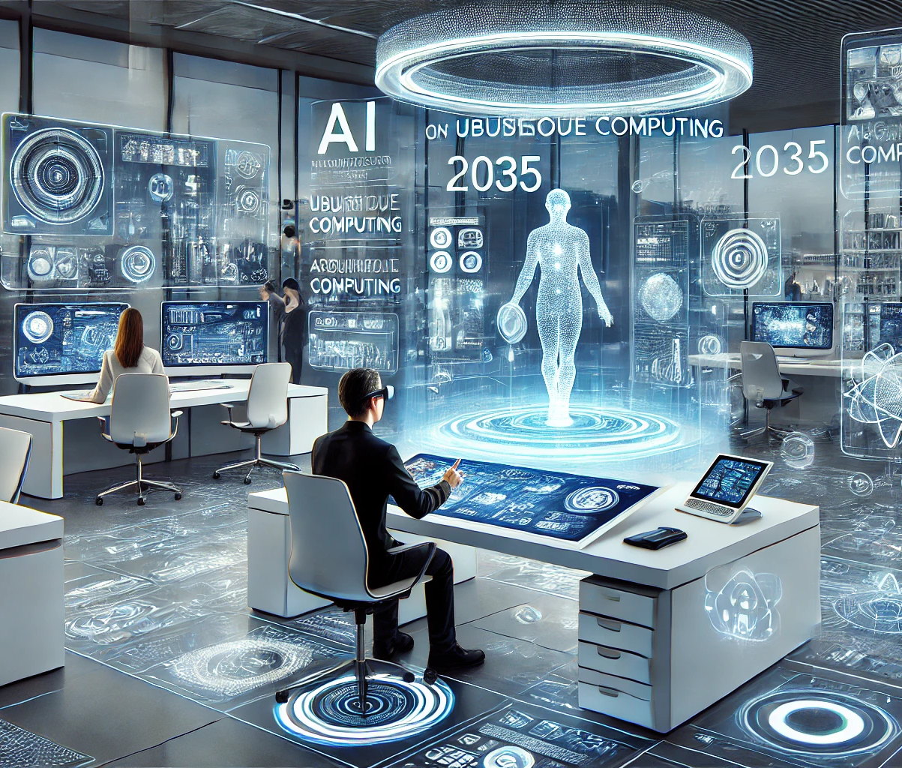
The Future of Computing at Home
Inspired by Mark Weiser's Vision of Ubiquitous Computing

Slide 2
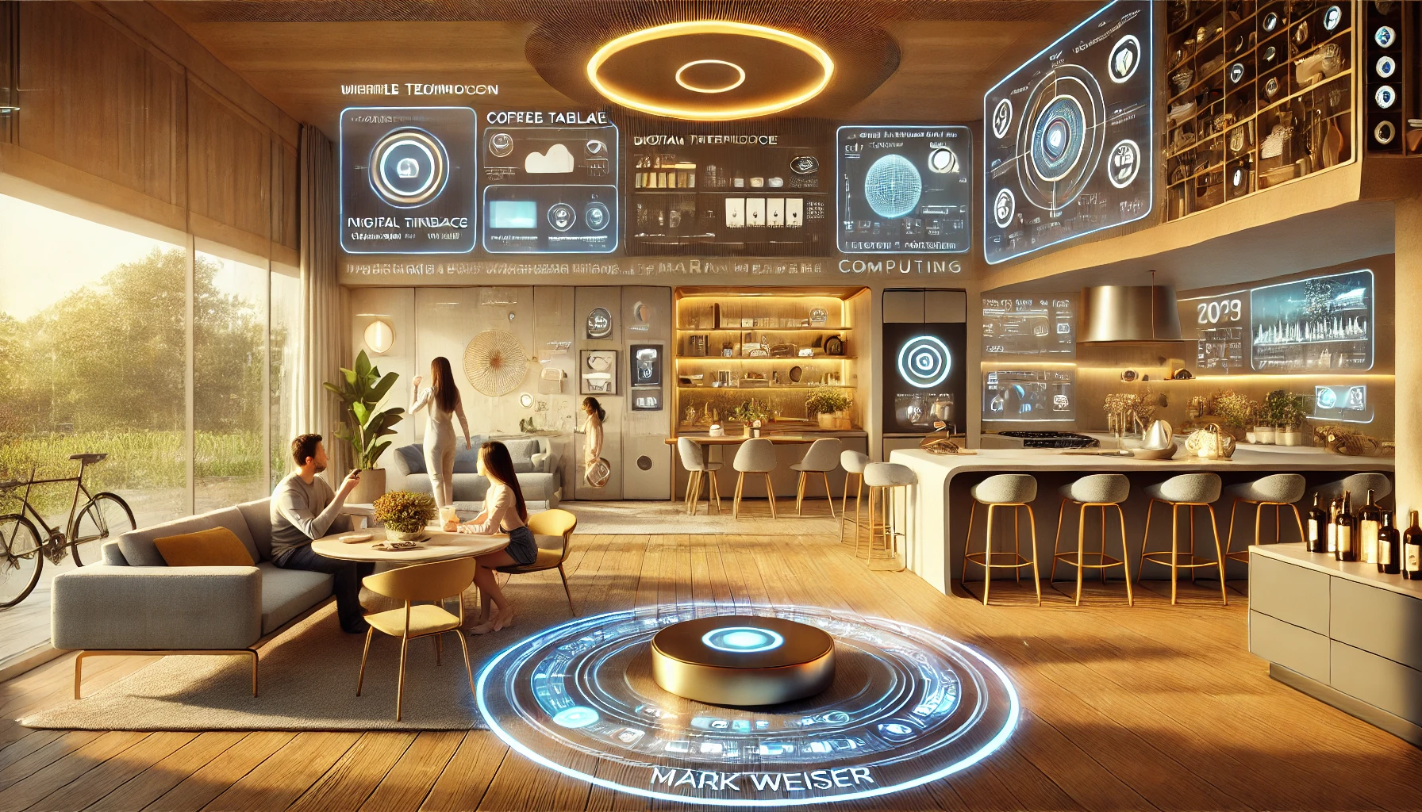
In 2035, our homes seamlessly integrate technology into everyday life. Walls act as interactive displays, smart surfaces respond to touch and gestures, and AI-driven assistants anticipate our needs. A coffee table suggests books, a kitchen auto-generates recipes, and smart mirrors provide real-time data. Unlike today’s screens, future computing will blend into our environment, allowing interaction without distraction. Mark Weiser’s vision of ‘calm computing’-where technology is pervasive yet invisible-will define our homes, making them more intuitive, intelligent, and human-centered.
Text: Using ChatGPT-4 and DeepSeek for conciseness and tone.
Images: Generate visual via DALL-E 3 (integrated into ChatGPT Plus).

